Slide 1

Use Case 3: Unified Social Registry for Enhanced Delivery of Public Welfare Services

Slide 2


Plain-English Walkthrough
How the system identifies likely welfare fraud and helps teams act quickly and fairly.
What We Will Cover
Storage
Data Node
Graph Hub
System At A Glance
1) Our approach in simple terms
2) Current accuracy and what it really means
3) How we evaluate performance
4) Key risks and how we reduce them
Raw social registry data
Verified relational records
Connected fraud intelligence graph
Presentation deck with live frontend screenshots | April 2026

Slide 3
Our Approach In Simple Terms
Step 1: Understand all incoming data
Step 2: Detect and prioritize risk
We read uploaded documents and convert messy text into usable facts and connections.
We analyze social registry records, flag risky patterns, and send the highest-risk cases for review first.
Advance-RAG | KG Fraud Intelligence

Slide 4
How Detection Works (Simple Rule Logic)
Example Rules
- Age above 110 -> likely ghost beneficiary (85%)
- Date of birth in the future -> invalid record (90%)
- Exact duplicate identity fields -> possible duplicate claim (92%)
These scores show rule confidence, not final guilt.
Advance-RAG | KG Fraud Intelligence

Slide 5
How Each Screen Helps A Non-Technical User
Ask Questions
See Connections
Take Action
forum
account_tree
dashboard
Staff can ask plain-language questions and get evidence-backed answers.
The map view shows how people, operators, and claims are linked.
The dashboard turns alerts into assignable tasks for field teams.
Advance-RAG | KG Fraud Intelligence

Slide 6
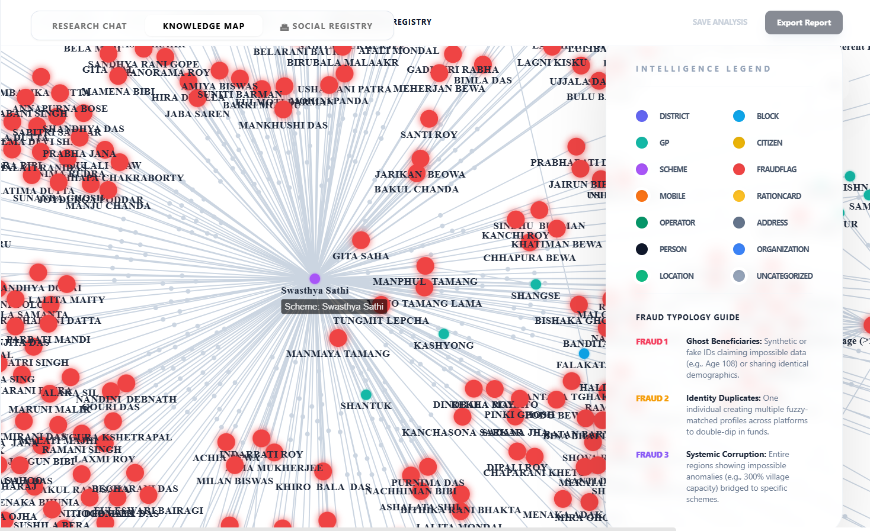
Why The Knowledge Map Matters
LIVE CONNECTION MAP
Red nodes highlight unusual patterns. Teams can visually trace who is connected to what, and why a case was flagged.
Advance-RAG | KG Fraud Intelligence

Slide 7
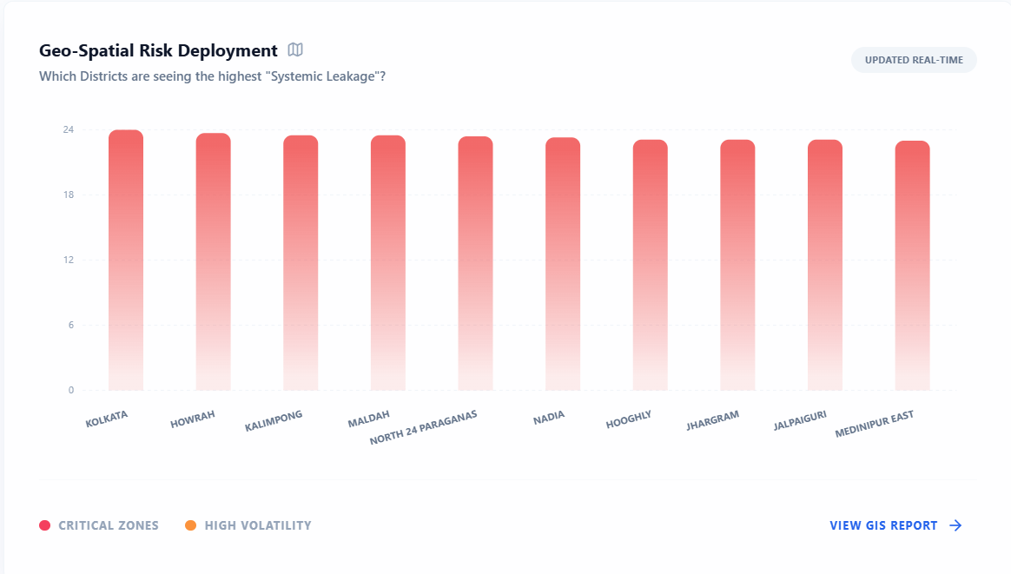
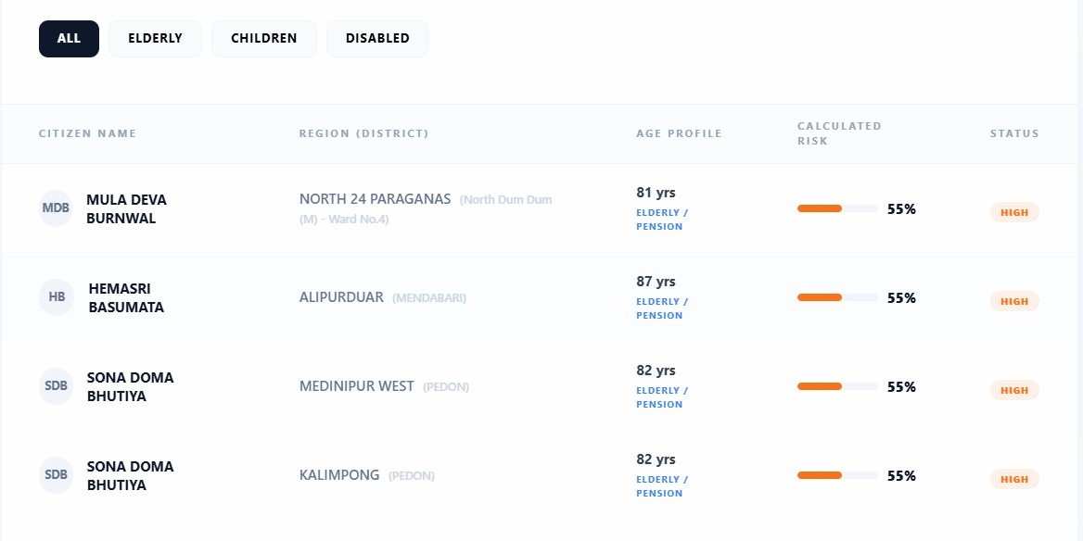
Dashboard View: Risk targeting by location and beneficiary segment
Where Risk Is Concentrated (District View)
District-level risk hotspots
Map insights help teams focus limited field capacity where potential misuse is highest.
Advance-RAG | KG Fraud Intelligence

Slide 8
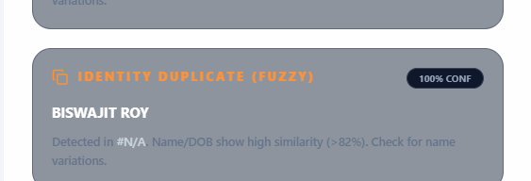
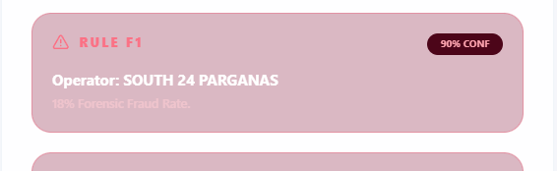
Live Alerts For Investigation Teams
Duplicate identity alerts
Each alert includes confidence, reason, and severity so teams can prioritize quickly.
Operator integrity alerts
Advance-RAG | KG Fraud Intelligence

Slide 9
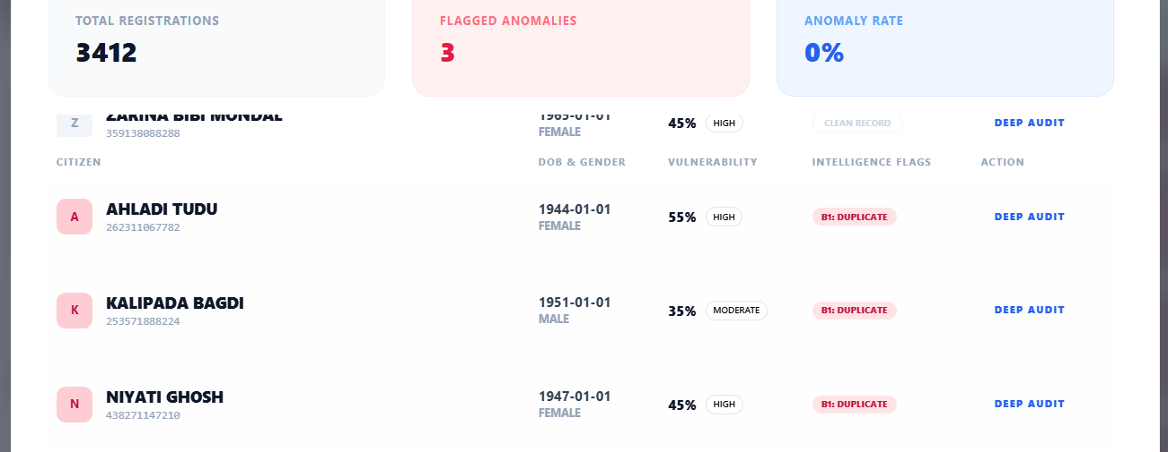
Case Drill-Down For Auditors
DETAILED AUDIT VIEW
Advance-RAG | KG Fraud Intelligence

Slide 10
Accuracy: What We Can Claim Today
How We Define Accuracy
Current Signal Quality
Practical Goal
We track precision (true alerts), recall (missed fraud), false-positive rate, and time-to-triage.
Current rule confidence in this deck ranges from 85% to 92%. This reflects rule strength, not final confirmed fraud outcomes.
Increase true positives while reducing unnecessary field investigations and citizen friction.
Advance-RAG | KG Fraud Intelligence

Slide 11
Evaluation Process (Operational)
01 | Detect | System flags suspicious cases based on rules and graph links.
02 | Explain | Each alert includes evidence path and reason for transparency.
03 | Prioritize | Cases are ranked by severity and confidence.
04 | Assign | High-priority cases are sent to responsible teams.
05 | Verify | Field audit confirms, rejects, or updates the case.
06 | Learn | Outcomes feed back to improve rules and thresholds.
Advance-RAG | KG Fraud Intelligence

Slide 12
What Citizens, Teams, And Leadership Gain
Frontline Investigators
Program Operations
Leadership
Clear explanations, faster triage, and less manual digging per case.
Better district visibility, better workload planning, and quicker interventions.
Reliable KPIs: precision trend, false-alert burden, closure speed, and service integrity.
Advance-RAG | KG Fraud Intelligence

Slide 13
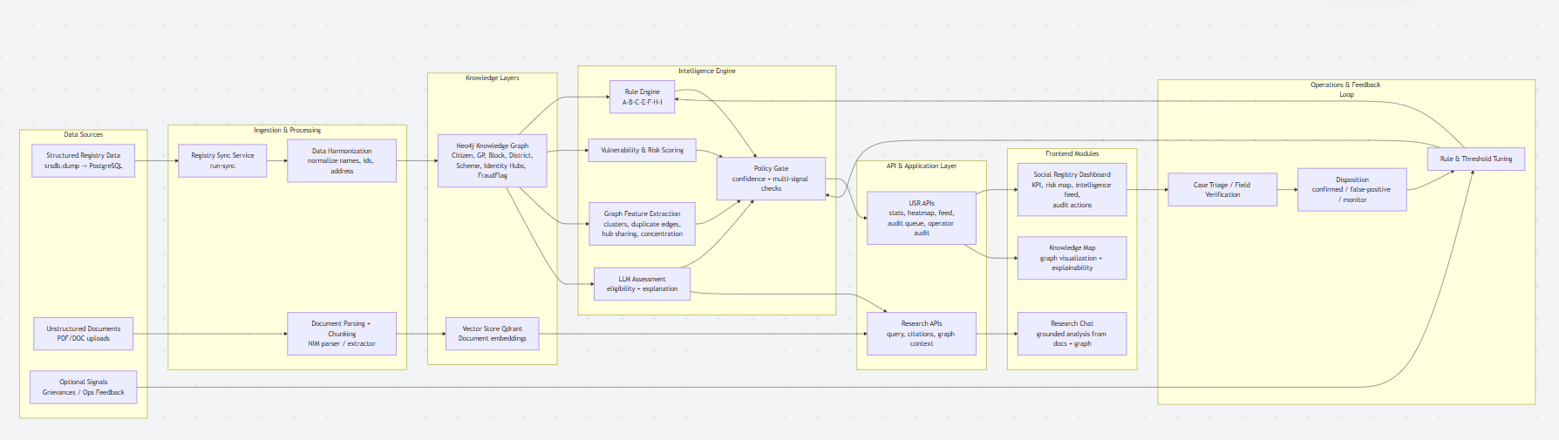
Architecture Flow (Data To Decision)

Slide 14
Key Risks We Foresee For The Client
1. DATA QUALITY RISK
- Incomplete or inconsistent beneficiary records can create noisy alerts.
- Mitigation: data quality checks, mandatory fields, and source-level trust scoring.
2. FALSE-POSITIVE RISK
- Too many weak alerts can overload teams and delay real cases.
- Mitigation: confidence thresholds, severity tiers, and monthly precision reviews.
3. PRIVACY AND GOVERNANCE RISK
- Sensitive citizen data can be exposed if controls are weak.
- Mitigation: role-based access, masking, audit logs, and retention policies.
4. OPERATIONAL ADOPTION RISK
- Teams may not use the platform consistently without clear ownership.
- Mitigation: clear SOPs, role-wise dashboards, and training-led rollout.
5. POLICY MISMATCH RISK
- Alert actions may conflict with local approval rules or legal process.
- Mitigation: configurable workflows and policy sign-off before go-live.
6. SCALING AND MAINTENANCE RISK
- Alert volume can grow faster than review capacity.
- Mitigation: phased rollout, SLA monitoring, and periodic rule tuning.
Advance-RAG | Client Discovery Questionnaire

Slide 15
Simple Closing Summary
OUR APPROACH
Use connected data + transparent rules to find high-risk cases early and explain every alert clearly.
ACCURACY, EVALUATION, AND RISK CONTROL
Track precision/recall/false positives through field verification, then continuously tune rules while protecting privacy and operations.
Advance-RAG | Knowledge Graph Fraud Intelligence

